Slide 1
Sustainability in space
So that we don’t die

Slide 2

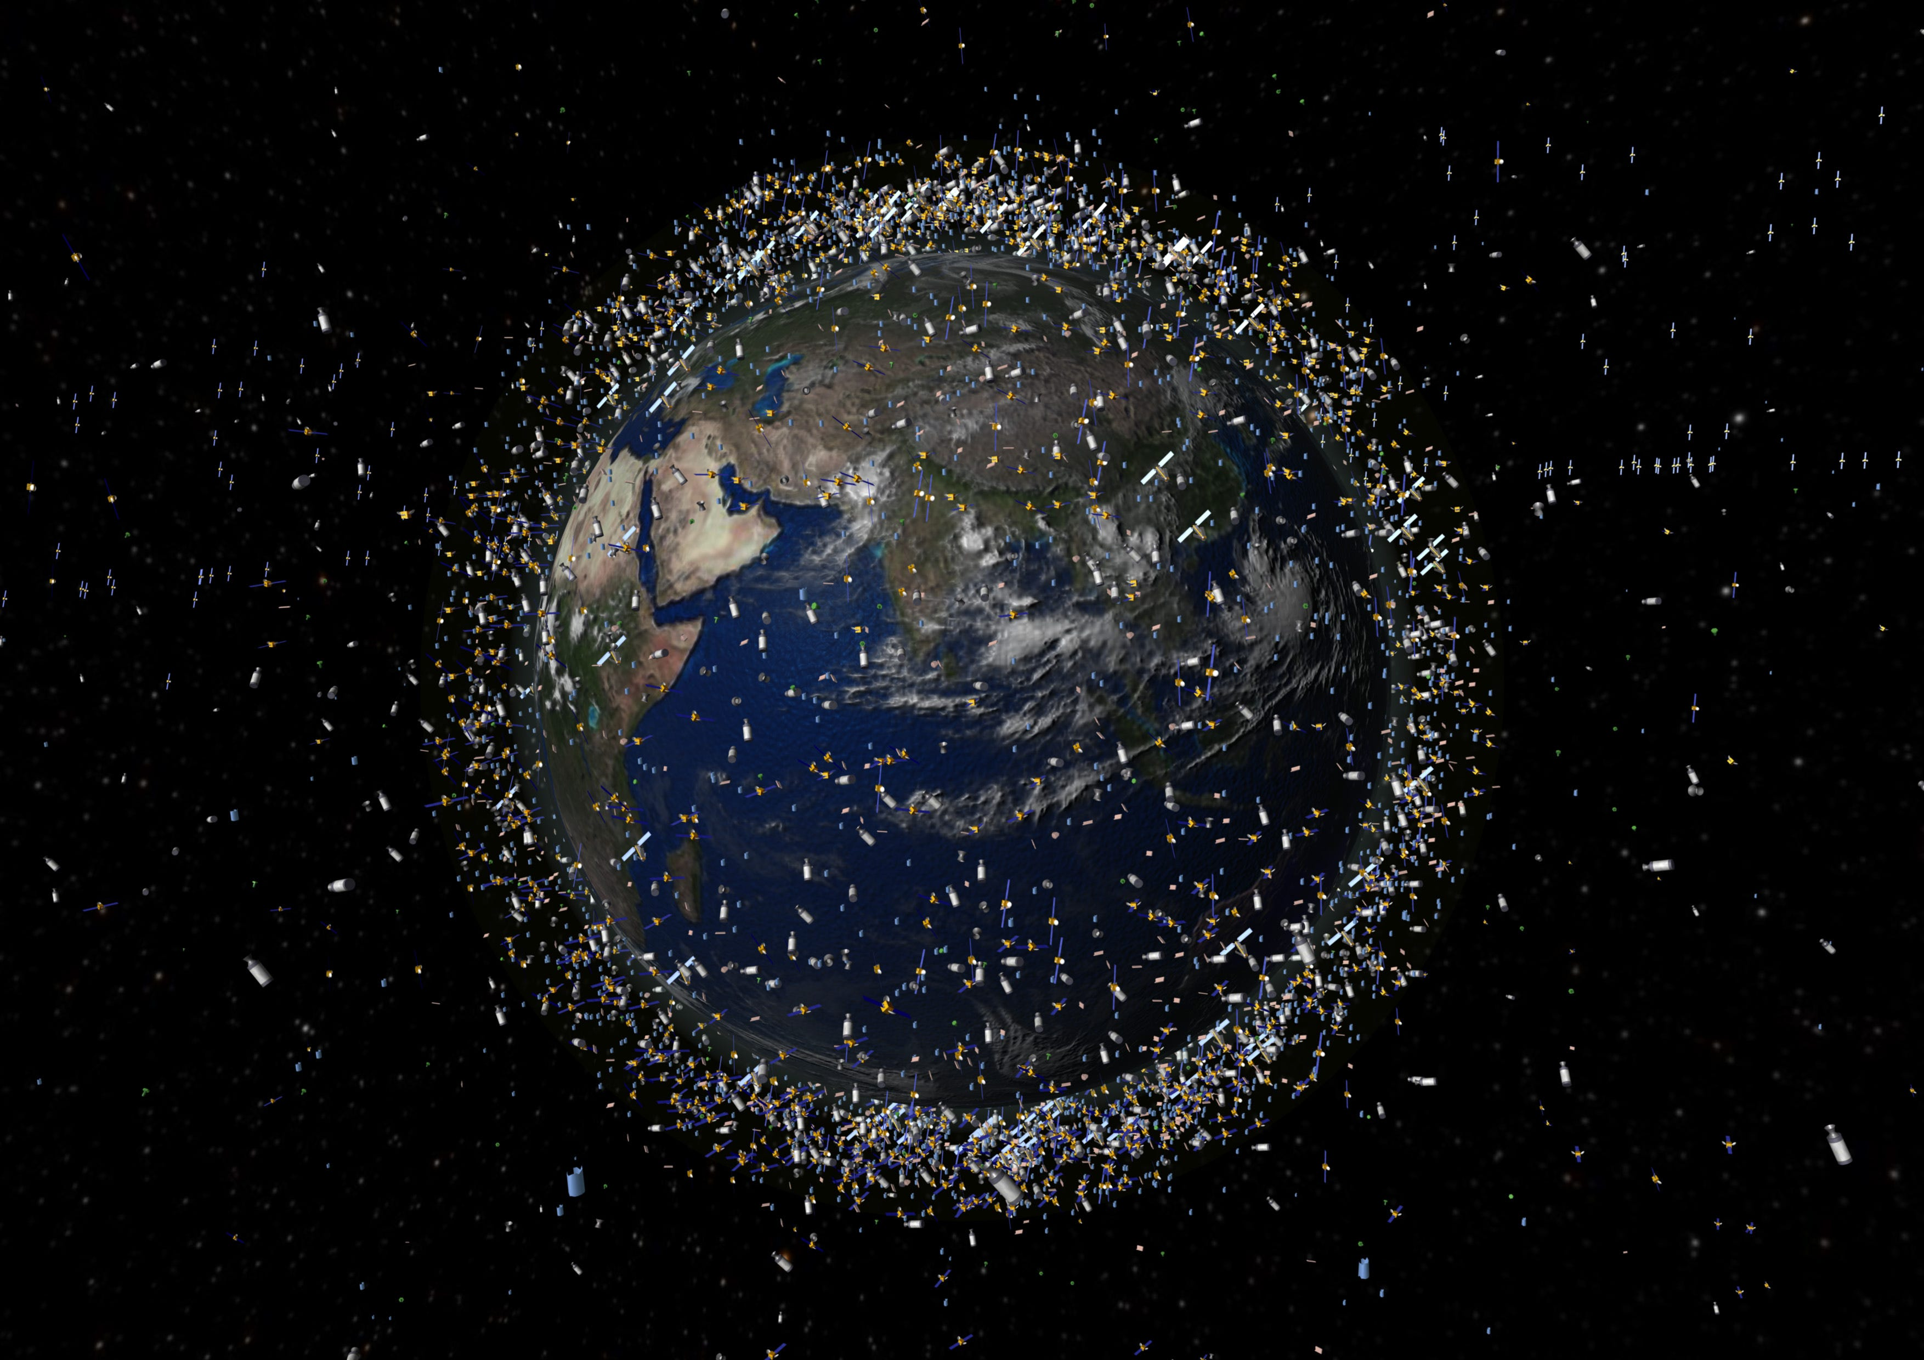
What is space sustainability
“budgetary” or “programmatic” sustainability (NASA)
the ability of all humanity to continue to use outer space for peaceful purposes and socioeconomic benefit over the long term. (SWF)
Notes:
Secure World Foundation

Slide 3




Why Is It Important?
A growing number of actors are using outer space for an increasing variety of socioeconomic and national security benefits.
Many of these space activities use the same regions of Earth orbit, leading to crowding and potential physical and electromagnetic interference.
Unsafe or irresponsible actions by one actor can have long-term consequences for all.
If we do not use space sustainably, the cost of using space will increase, which could make it too expensive to continue to use space for:
National and international security
Earth observation
Telecommunications
Satellite navigation
Scientific Exploration
Economic development

Slide 4
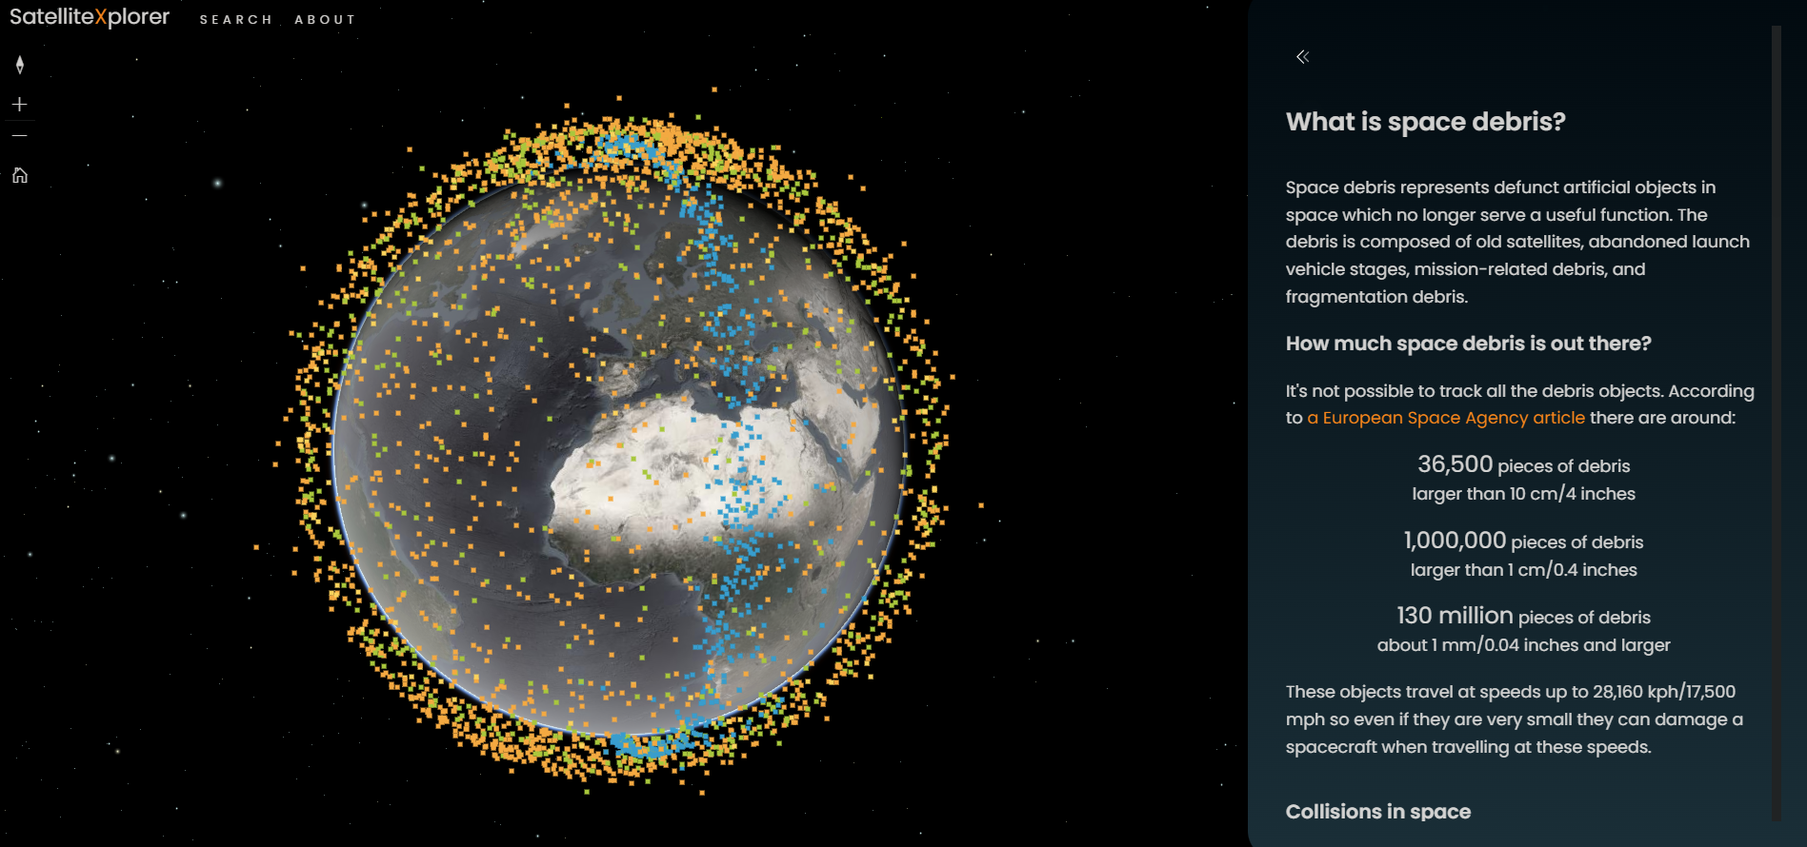
The Space Environment
https://geoxc-apps.bd.esri.com/space/satellite-explorer/
Notes:
Debris is a result of human activities in outer space.

Slide 5
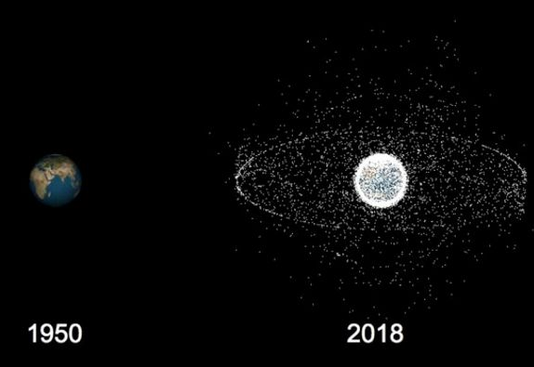
Accidents and Irresponsible Actions
Collisions and explosions can create large amounts of space debris. This debris poses a risk to everyone operating in space,
Conflict in space could have devastating consequences for the long-term sustainability of space. Destroying satellites can create huge amounts of debris that could render certain areas of Earth’s orbit unusable. Misperceptions and mistrust with regard to military activities in space could serve as a catalyst for conflict in space or on Earth. (ASAT)
Frequency Interference through improper configuration or use of radio transmission equipment on satellites or on the ground can interrupt satellite communications
Notes:
ASAT = Anti-satellite weapons
Russia test => ISS to take shelter
Kessler syndrome

Slide 6
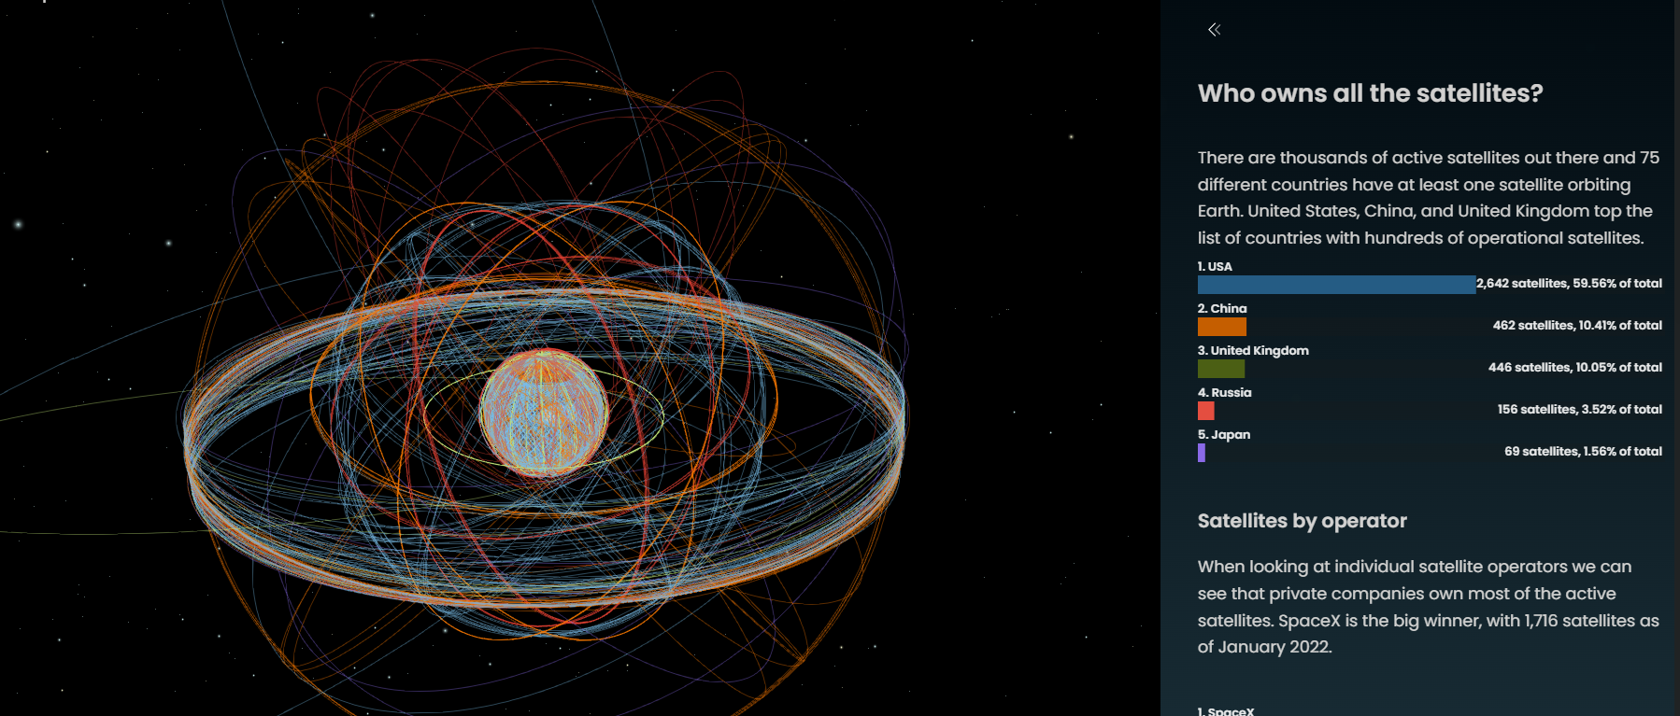
Radio frequency interference, either from natural sources or man-made and either intentional or unintentional, can have significant negative impacts on our ability to use space. Many satellites also use radio waves as an important element in their functioning, including retransmitting television broadcasts or transmitting imagery or scientific data that they have collected. Interference can be generated by other satellites, terrestrial systems, or space weather.

Slide 7
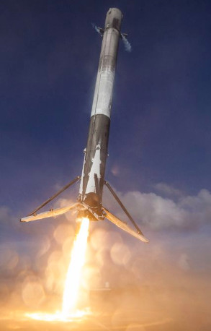
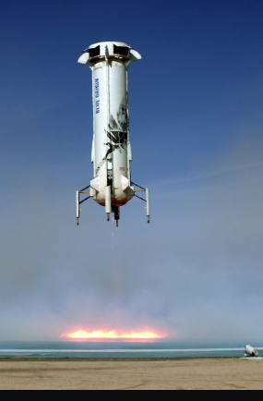
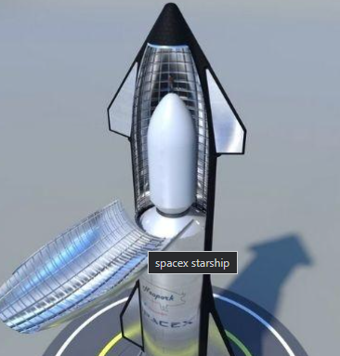
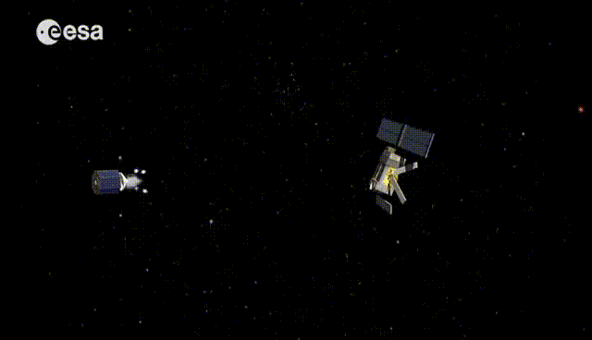
What can we do?
Increasing Awareness of the Challenges to Space Sustainability
Reusability(SpaceX: Falcon 9, Starship; Blue Origin; Orbex)
Try to burn up small, or bring back large space debris (SpaceX Starship)

Slide 8
Bibliography:
Space Sustainability | Secure World Space Sustainability | Secure World (2022). Available at: https://swfound.org/our-focus/space-sustainability/ (Accessed: 10 October 2022).
NASA technical reports https://ntrs.nasa.gov/citations/20160011405
SatelliteXplorer https://geoxc-apps.bd.esri.com/space/satellite-explorer/
Several YouTube videos and podcasts

